Slide 1
Microsoft Teams Developer
Tabs and Connectors

Slide 2

Connectors
Connectors vs Notification Bots
Connector Registration
Inline connector experience
Demo

Slide 3
Connectors vs Notification-only Bot
Connectors and Notification-only bots have similar characteristics. The following are considerations for each:
Connector
Configured for a specific channel
Added via specific Connector experience
Notification-only bot
Configured for an entire Team Added to Team using the App experience
Can work in Personal scope
Can post to Activity Feed
Notes:
Use the Microsoft.Bot.Connector.Teams package to get extension methods for Microsoft Teams. Handles the parsing of the Bot Framework payload with Teams-specific functionality.

Slide 4
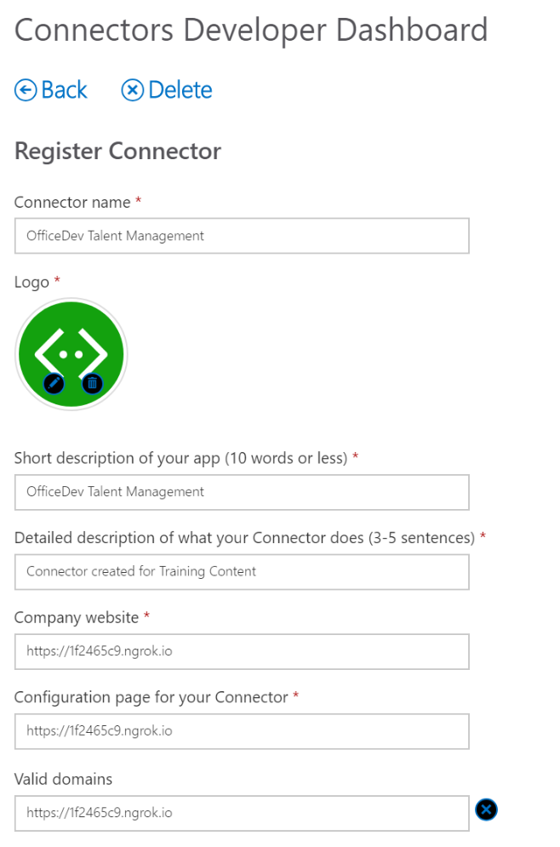
Connectors Developer Dashboard
Register a Connector
New Connector section
Field | Notes
Connector Name | Shown in connector list
Logo | Shown in connector list
Short description | Shown in connector list
Detailed description | Shown when adding / configuring a connector
Company website | Shown when adding / configuring a connector
Configuration page for your Connector | Shown in an IFRAME in the Microsoft Teams app for configuration
Valid domains | Domains for which Actions are supported
Notes:
Provide data in well-defined fields. Rendering is handled by host application

Slide 5
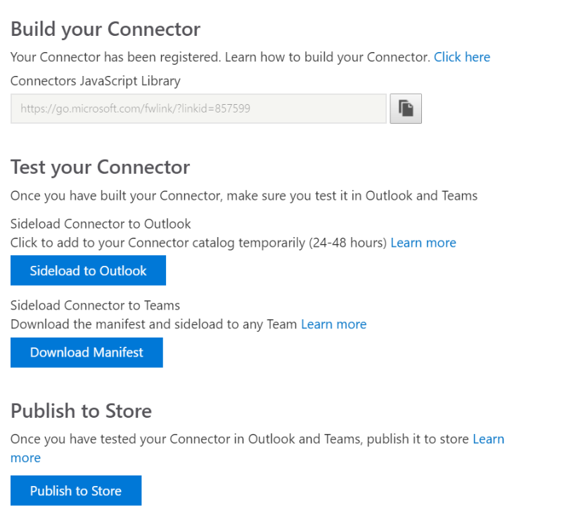
Connectors Developer Dashboard
Register a Connector
Registered Connector section
Item | Notes
Build your Connector | Provides a link to the Microsoft Teams javascript file
Test your Connector – Download manifest | Provides a manifest.json file with the connector registration added.
Publish to Store | For publicly-available connectors, initiates the review/publish process
Notes:
Provide data in well-defined fields. Rendering is handled by host application

Slide 6
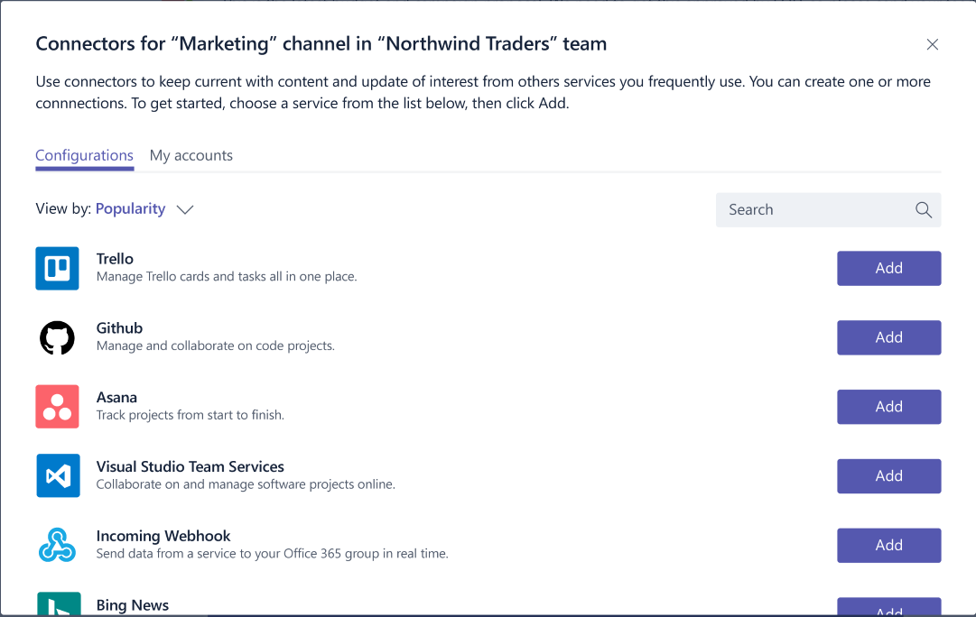
Inline Connector Experience
Integrating the configuration experience
The user clicks on your connector to begin the configuration process.
Teams will load your configuration experience in line.
The user interacts with your web experience to complete the configuration.
The user presses "Save", which triggers a callback in your code.
Your code will process the save event by retrieving the webhook settings Your code should then store the webhook to post events later.

Slide 7
Demo Add a Connector to a Channel

Slide 8

Summary
Connectors vs Notification Bots
Connector Registration
Inline connector experience

Slide 9
Thank you

